Slide 1
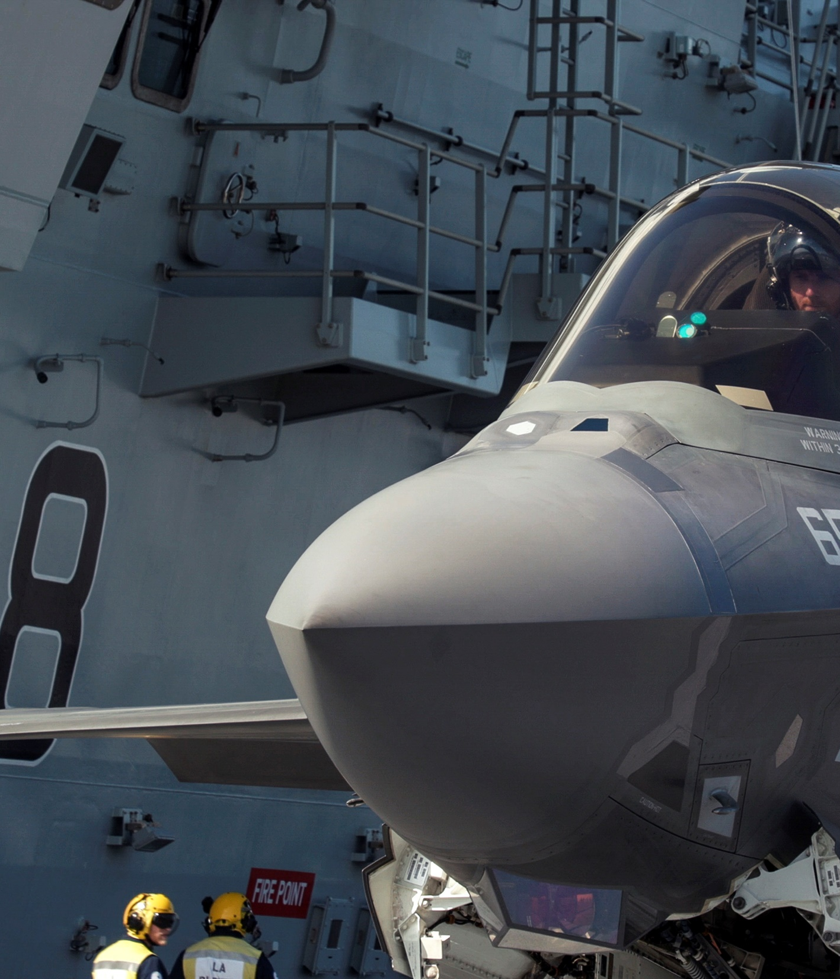

INTRODUCTION TO THE
DEPARTMENT OF DEFENSE (DoD)
Mary Margaret Evans & Sinclair Harris
March 2017

Slide 2
DISCUSSION OUTLINE
This course provides an overview of the following:
DoD mission and organization
Roles of the Secretary of Defense staff, the military services, Joint staff, and combatant commanders
Key strategy documents and important decision processes
DoD budget

Slide 3
THE DoD MISSION
“The mission of the Department of Defense is to provide the military forces needed to deter war and to protect the security of our country”
Construction began September 11, 1941
First occupants moved in on April 29, 1942
Office of the Secretary of Defense
~ 23,000 military and civilian employees
Joint Chiefs of Staff
Military Services
3,705,793 square feet
17.5 miles of corridors
Defense Agencies
Combatant Commands
Source: DoD Defense link website: www.defense.gov, Jan. 2010.

Slide 4
SCOPE OF THE DoD BUSINESS
475,000 DoD contractors
$4.19B in contracts
124 large sites (value > $879.36B)
4,035 smaller sites
Army: 16,000 wheel and tracked vehicles/5,117 aircraft/300 watercraft
Air Force: 5,400 aircraft
Navy: 450 ships* and 4,000 aircraft
DoD's Total Obligatory Authority in 2016
1,326,273 active military personnel
851,724 civilian personnel
$585B
561,975 buildings and structures
24.9M acres of real estate
168 accredited schools in 11 countries
73,100 kids K–12
* Includes Military Sealift Command.
Sources: DoD Base Structure Report 2015, Annual Aviation Inventory and Funding Plan 2016, The Army Tactical Wheeled Vehicle Strategy, and Report to Congress on the Annual Long-Range Plan for Construction of Naval Vessels for Fiscal Year 2016.

Slide 5
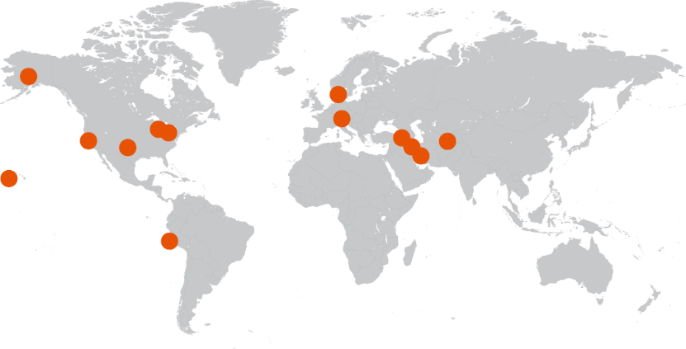

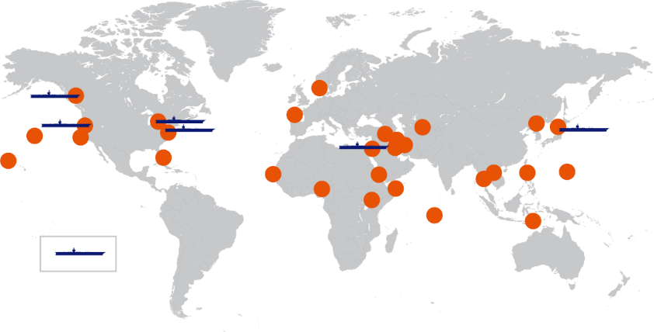
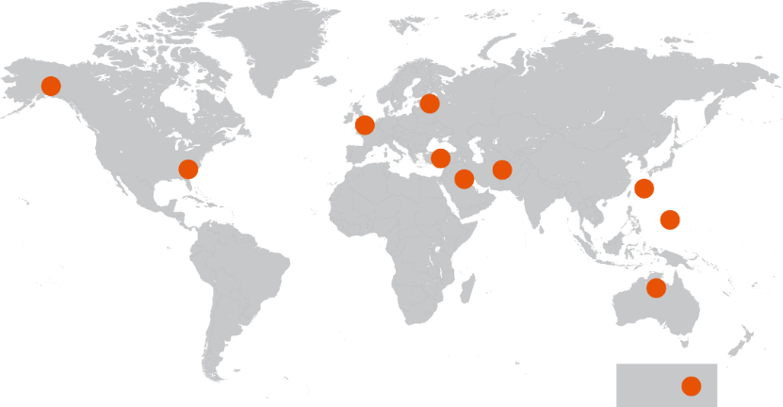
ANY DAY IN THE MILITARY: DECEMBER 2016
THE ARMY
AS OF DEC. 18
THE MARINE CORPS
AS OF DEC. 16
Arctic Ocean
Arctic Ocean
North America
Europe
Asia
Asia
North America
Europe
Atlantic Ocean
Pacific Ocean
Atlantic Ocean
Pacific Ocean
Pacific Ocean
Africa
Africa
South America
Pacific Ocean
South America
Indian Ocean
Australia
Indian Ocean
Australia
THE NAVY
THE AIR FORCE
AS OF DEC. 17
Arctic Ocean
Arctic Ocean
Asia
Europe
Asia
North America
Europe
North America
Atlantic Ocean
1
Atlantic Ocean
Pacific Ocean
Africa
Africa
Pacific Ocean
Pacific Ocean
South America
South America
Indian Ocean
Indian Ocean
Australia
Australia
Aircraft Carrier
Antarctica
Army | Navy | Air Force | Marine Corps
12 | 28 | 11 | 14

Slide 6
CIVILIAN CONTROL OF THE MILITARY
Organization | Delegated Title 10 Authority/Function
Office of the Secretary of Defense | Authority, direction and control…policy, planning, and management
Joint Chiefs of Staff | Advise POTUS, SECDEF, HLS, and NSC…best military advice
Department of the Army | Man, Train, and Equip…10 U.S. Code
Department of the Navy | Man, Train, and Equip: Navy and Marine Corps…10 U.S. Code
Department of the Air Force | Man, Train, and Equip…10 U.S. Code
Combatant Commanders | Command and Control of U.S. Military Forces…Geographic and Functional
Defense Agencies/Field Activities | Established by the SECDEF to perform a supply or service activity common to more than one military department
The framers of the U.S. Constitution worked to ensure the military would be under civilian control....Article II, Section 2 states,
”The President shall be the Commander in Chief of the Army and Navy of the United States, and of the Militia of the several States
when called into the actual Service of the United States."

Slide 7
PUBLIC LAW: TITLE 10—ARMED FORCES
Title 10—Armed Forces
Subtitle A—General Military Law
Subtitle B—Army
Subtitle C—Navy and Marine Corps
Subtitle D—Air Force
Subtitle E—Reserve Components
Title 10 of the United States Code outlines the role of armed forces in the United States Code
It provides the legal basis for the roles, missions, and organization of each of the services as well as the United States Department of Defense
Part I—Organization and General Military Powers
Part II—Personnel
Part III—Training and Education
Part IV—Service, Supply, and Procurement
Source: http://www.law.cornell.edu/uscode/html/.

Slide 8
CHAINS OF COMMAND: SUPPORT AND OPERATIONAL
PRESIDENT
SECRETARY OF DEFENSE
Support Responsibilities
(Man, train, equip, maintain)
Operational Responsibilities
Office of the
Secretary of Defense
SecArmy
CSA
SecNavy
CNO/CMC
Sec Air Force
CSAF
thru
CJCS
DoD Agencies
& Field Activities
Army
Cmds
Navy/USMC
Cmds
AF
Cmds
Combatant Commands
Forces, Materiel, and Resources
Combat Support Agencies
Source: FY 2008 DoD Performance Plan.
Notes:
From the point of view of understanding how the military operates, this is a very important slide.
Notice that there are two chains of command, a support chain and an operational chain.
The secretaries of the military departments and the military chiefs of the services do NOT have command authority over their forces in the field. As shown on the slide, the military departments have the responsibilities of manning, training, equipping, and maintaining the forces.
The forces are assigned to combatant commands, and command exercised by the commanders-in-chief of the commands. Thus, for example, an Army division operating in Europe has a chain of command that goes through the Commander-in-Chief, European Command, directly to the Secretary of Defense, not to the Chief of Staff of the Army. Nevertheless, it IS the responsibility of the Army to ensure that those forces assigned to the European Command have the proper training and resources to carry out their mission.

Slide 9




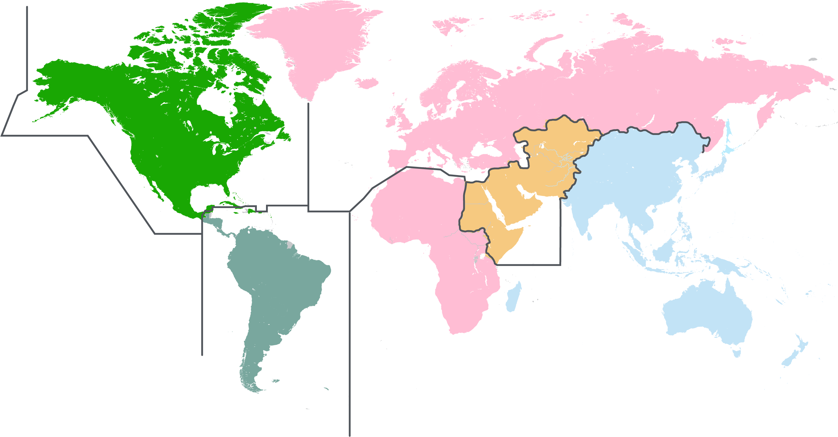










UNIFIED COMMAND PLAN: SCOPE AND REACH OF THE MILITARY
Military Services
(Providers)
Geographic Combatant Commanders (GCC)
(Operators)
Functional Combatant
Commanders
(Operators)
USEUCOM
USNORTHCOM
USPACOM
AFRICA COMMAND
USCENTCOM
USPACOM
USSOUTHCOM

Slide 10
DEPARTMENT OF DEFENSE
SECRETARY OF DEFENSE
Inspector Generals
DEPUTY SECRETARY OF DEFENSE
Office of the Secretary of Defense
Department
of the Army
Department
of the Navy
Department
of the Air Force
Joint Chiefs of Staff
Chairman of the Joint Chiefs of Staff
Under Secretaries of Defense, Assistant Secretaries of Defense, other specified officials
Secretary of the Army
Secretary of the Navy
Secretary of the Air Force
The Joint Staff
Office of the Secretary of the Army
The Army
Staff
Office of the Chief of Naval Operation
Office
of the Secretary of the Navy
Commandant &
Headquarters Marine
Corps
Office
of the Secretary of the Air Force
The
Air Force Staff
Vice Chairman JCS, Chief of Staff Army, Chief of Naval Operations, Chief of Staff Air Force, Commandant of the Marine Corps, Chief of the National Guard Bureau
Defense Agencies (20)
DoD Field Activities (8)
The Army
& Reserves
The Navy
& Reserves
The Marine Corps & Reserves
The Air Force
& Reserves
Combatant Commands (10)
The Coast Guard
& Reserves
Source: DoD Organizational and Management Planning 2012.
Notes:
Taking a look at this chart we see
Three military departments-Army, Navy, and Air Force. The Marine Corps is in the Department of the Navy. The Coast Guard, although one of the armed forces, in peacetime is under the Department of Transportation.
The combatant commands--we’ll talk more about them later--which are the military forces in the field, report directly to the Secretary of Defense. The Secretary, however, provides direction to the combatant commands through the Chairman, Joints Chief of Staff, hence the dotted line.
The Defense Agencies and Field Activities--more about them, too, in a moment, are under the operational control of one of the OSD staff offices.

Slide 11
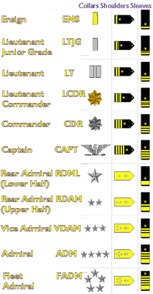
OFFICER INSIGNIA
ARMY, MARINE CORPS, AIR FORCE
GOVERNMENT CIVILIANS
NAVY AND COAST GUARD
Undersecretary of Defense ( 4 Star)
Assistant Secretary of Defense (3 Star)
Deputy Under Secretary of Defense or
Deputy Assistant Secretary of Defense (2 Star)
Senior Executive Service–Assistant
Deputy Under Secretaries (1 Star)
Other Senior Executive Service (1 Star)
GS-15 Civil Service Members
GS-14 Civil Service Members
GS-13 Civil Service Members
Admiral
Vice Admiral
Rear Admiral (upper half)
Rear Admiral (lower half)
Captain
Commander
Lieutenant Commander
Lieutenant
Lieutenant Junior Grade
Ensign
General
Lt General
Major General
Brigadier General
Colonel
Lt Colonel
Major
Captain
1st Lieutenant
2nd Lieutenant
Civilian Managers

Slide 12
ENLISTED PERSONNEL INSIGNIA
ARMY ENLISTED
NAVY & COAST GUARD ENLISTED
E-1
No Insignia Private
E-1
Seaman Recruit
Seaman Apprentice
Seaman
Petty Officer Third Class
Petty Officer Second Class
Petty Officer First Class
Chief Petty Officer
Senior Chief Petty Officer
Master Chief Petty Officer, Master Chief Petty Officer of the Navy
E-2
Private
E-2
E-3
Private First Class
E-3
E-4
Corporal
E-4
E-5
Sergeant
E-5
E-6
Staff Sergeant
E-6
E-7
Sergeant First Class
E-7
E-8
First Sergeant, Master Sergeant
E-8
E-9
Sergeant Major, Command Sergeant Major, Sergeant Major of the Army
E-9

Slide 13
ENLISTED PERSONNEL INSIGNIA
MARINES ENLISTED
AIR FORCE ENLISTED
E-1
No Insignia Private
E-1
No Insignia Airman Basic
Airman
Airman First Class
Senior Airman
Staff Sergeant
Technical Sergeant
First Sergeant, Master Sergeant
First Sergeant, Senior Master Sergeant
First Sergeant, Chief Master Sergeant
Chief Master Sergeant of the Air Force, Command Chief Master Sergeant
E-2
Private First Class
E-2
E-3
Lance Corporal
E-3
E-4
E-4
Corporal
E-5
E-5
Sergeant
E-6
E-6
Staff Sergeant
E-7
E-7
Gunnery Sergeant
E-8
E-8
First Sergeant, Master Sergeant
E-9
Sergeant Major, Master Gunnery Sergeant, Sergeant Major of the Marine Corps
E-9

Slide 14

PILLARS OF DEFENSE STRATEGY
DoD POLICY—DIRECTIVES, INSTRUCTIONS, AND REGULATIONS
National
Security
Strategy
2015
Public
Law
Title 10
NDAA 2017
National Defense
Strategy 2012 &
National Military
Strategy 2015
EXECUTION OF DoD MISSION
Quadrennial
Defense
Review
2014
Defense
Planning
& Fiscal
Guidance
2017

Slide 15

DoD DECISION MAKING
Joint Capabilities
Integration & Development
System (JCIDS)
CJCSI 3170.01F
01 Mar. 2009
JCS/Service
Chiefs Oversight
DoD 5000 Series
20 Nov. 2007
DoDD 7045.14
21 Nov. 03
Planning, Programming, Budgeting &
Execution Process (PPBE)
Defense
Acquisition
System
Milestone Decision
Authority (MDA)
Oversight
DEPSECDEF
Oversight
Notes:
The Department of Defense has three principal decision-making support systems, all of which
were significantly revised in 2003. These systems are the following:
Planning, Programming, Budgeting and Execution (PPBE) Process - The Department's
strategic planning, program development, and resource determination process. The PPBE
process is used to craft plans and programs that satisfy the demands of the National Security
Strategy within resource constraints.
Joint Capabilities Integration and Development System - The systematic method
established by the Joint Chiefs of Staff for assessing gaps in military joint warfighting
capabilities and recommending solutions to resolve these gaps. To ensure effective integration
of the capabilities identification and acquisition processes, the Joint Capabilities Integration and
Development System guidance (CJCS Instruction 3170.01 and Manual 3170.01) was developed
in close coordination with the revision to the acquisition regulations (DoD 5000 series).
Defense Acquisition System - The management process by which the Department acquires
weapon systems and automated information systems. Although the system is based on
centralized policies and principles, it allows for decentralized and streamlined execution of
acquisition activities. This approach provides flexibility and encourages innovation, while
maintaining strict emphasis on discipline and accountability.
Together three systems provide an integrated approach to strategic planning, identification of needs for military capabilities, systems acquisition, and
program and budget development.

Slide 16
JOINT CAPABILITIES INTEGRATION & DEVELOPMENT SYSTEM (JCIDS)
Initial Capabilities Document
DOTMLPF
Analysis
Materiel Change
Approval Process
Ideas for
Materiel
Approaches
Analysis
of Materiel
Approaches
Alternative N
ICD
Functional
Needs
Analysis
Alternative 2
Capability
Development
Document
Alternative 1
CDD
Strategic Policy
Guidance
JCIDS ANALYSIS
CPD
Capability
Production
Document
Functional Area Analysis
DOTMLPF
Changes
CJCSI 3180
Process
DOTMLPF Change
Recommendation
Joint Operations Concepts
DOCTRINE
ORGANIZATION
TRAINING
MATERIAL
LEADERSHIP & EDUCATION
PERSONNEL
FACILITIES
Policy Change
Recommendation
Joint Functional Concepts,
Joint Integrating Concepts,
Integrated Architectures
Notes:
Doctrine, Organization, Training, Materiel, Leadership and Education, Personnel and Facilities

Slide 17
DEFENSE ACQUISITION SYSTEM
USER NEEDS & TECHNOLOGY OPPORTUNITIES
Initial Operational
Capability (IOC)
Full Operational
Capability (FOC)
Material
Solution
Analysis
Technology
Development
Engineering
& Manufacturing
Development
Production
& Deployment
Operations
& Support
Low Rate Initial
Production (LRIP) & Initial Operational Test & Evaluation (IOT&E)
Full Rate
Production
(FRP) Decision
Review
Development
Decision
Post-Preliminary
Design Review
Critical
Design
Review
MILESTONES
A
B
C
(Program Initiation)
Sustainment & Disposal
PRE-SYSTEMS ACQUISITION
SYSTEMS ACQUISITION
Initial Capabilities
Document (ICD)
Capability Development
Document (CDD)
Capability Production
Document (CPD)
Relationship to Joint Capabilities Integration & Development System (JCIDS)
Decision points
Source: DoDD5000.1 & 5000.2.

Slide 18
STRATEGY TO BUDGET: PLANNING PROGRAMMING
BUDGETING & EXECUTION
PLANNING PHASE
PROGRAMMING PHASE
BUDGETING PHASE
EXECUTION PHASE
Chairman’s Program Recommendations
Resource Management Decisions
President’s Budget to Congress
Defense Planning Guidance (DPG)
Major Budget Issues
Funds Distribution
National Defense Strategy (NDS)
Chairman’s Program Assessment
Program/Budget Reviews
Budget Assessment Review
National Military Strategy (NMS)
National Security Strategy (NSS)
Program Objective Memorandum (POM)
Budget Estimate Submission
Budget Adjustment
Quadrennial Defense Review (QDR)
Fiscal Year Closeout
Fiscal Guidance

Slide 19

PLANNING, PROGRAMMING, BUDGETING, EXECUTION SYSTEM (PPBES)
SECDEF Strategic Planning Guidance (SPG): Feb. 2015
Service/Agency Program Objective Memorandums (POMs): May 2015
Program Decision Memorandums (PDMs): Aug. 2015
Budget Estimate Submissions (BES): Oct. 2015
Program Budget Decisions (PBDs): Dec. 2015
President’s Budget to Congress: Feb. 2016
Congress Approves Budget: 1 Oct. 2016
DoD Executes Budget: Oct. 2016 to Sep. 2017
PLAN
PROGRAM
PPBE FRAMEWORK
EXECUTE
BUDGET
While a budget only covers a single fiscal year, the budget process itself runs over multiple years as DoD spends current year money, formulates the budget request for the next year, and creates the Future Years Defense Program (FYDP) in the Program Objective Memorandum (POM).
Source: DoD budget.

Slide 20
DoD SERVICES ACQUISITIONS 53% OF DISCRETIONARY SPEND IN FY15
SERVICES ($143.7B)
SALARIES & EXPENSES ($129.5B)
Transportation Svcs ($6.4B)
4%
Logistics Mgmt Svcs ($33.0B)
3%
Acft, Ships/Subs Land Vehicles (45.3B)
35%
Misc S&E ($.07B)
0%
Knowledge Based Svcs ($4.5B)
23%
Facilities S&E ($6.7B)
5%
Construction Svcs ($10.7B)
8%
Medical Svcs ($12.68B)
9%
Clothing, Textiles, & Subsistence S&E ($9.5B)
8%
Facility Related Svcs ($23.1B)
16%
Electronic & Comm Svcs ($14.7B)
10%
Weapons & Ammo (18.5B)
14%
Equip Related Svcs ($23.1B)
11%
Sustainment S&E (30.1B)
23%
Research & Development ($22.4B)
16%
Electronic and Comm Equip (19.3B)
15%
Source: Data from Business Intelligence Tool; all services contracts with DoD as contracting department, 13 Feb. 16.
Numbers may not add due to rounding.

Slide 21
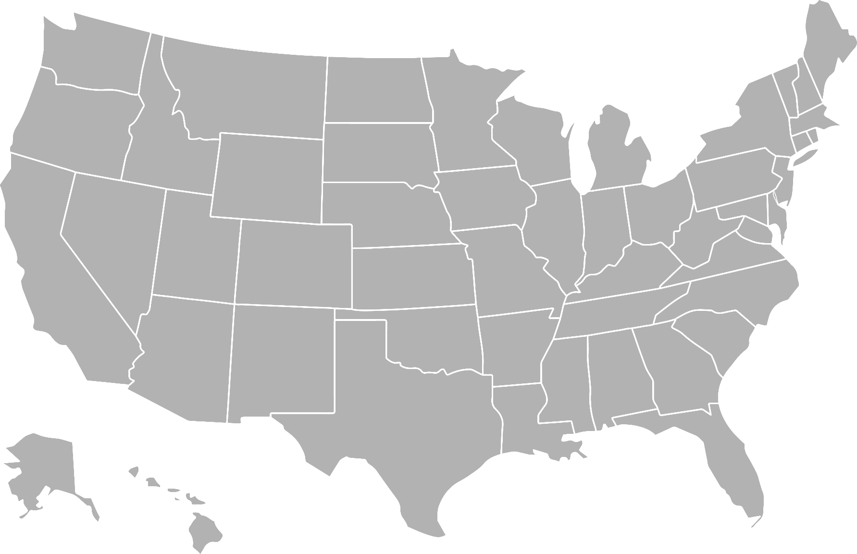
DoD FACILITIES: CONUS
Major U.S. Military Installations
Minor U.S. Military Installations
Publicly Known
Notes:
Source: https://standeyo.com/News_Files/Military/Mil_Install_map.html

Slide 22
TOP 10 DEFENSE CONTRACTORS (AWARDS $B)
RANK 2016 | TOP 10 COMPANIES | 2014 | 2015 | 2016
1 | Lockheed Martin Corporation | 25.0 | 29.2 | 27.6
2 | The Boeing Company | 16.8 | 13.9 | 18.0
3 | General Dynamics Corporation | 13.7 | 11.5 | 10.4
4 | Raytheon Company | 11.8 | 12.4 | 9.4
5 | Northrop Grumman Corporation | 7.3 | 7.3 | 6.1
6 | United Technologies Corporation | 5.8 | 6.7 | 4.2
7 | Huntington Ingalls Industries Inc | 4.0 | 3.1 | 3.8
8 | L-3 Communications Holdings, Inc. | 5.2 | 5.0 | 3.6
9 | BAE Systems PLC | 4.9 | 4.4 | 3.6
10 | Humana Inc. | 3.5 | 3.6 | 3.2
Total |  | $98.0 | $97.1 | $89.9
Number of Active Contracts: +216.3B
Source: www.USASpending.gov.
Notes:
The number of awards
$374.3B - FY11
$361.5B - FY12
$308B - FY13
$290B - FY14
$277B - FY15

Slide 23
TOP 10 NAICS SERIES FY13–16 ($K)
*
The North American Industry Classification Systems (NAICS) is the standard used by federal statistical agencies to classify business establishments in the U.S. business economy.
The 5416xx NAICS services encompasses firms in the Management, Scientific, and Technical Consulting Services industries.
LMI’s services fall under the NAICS services 5416xx.
3364xx
5417xx
5415xx
5413xx
5612xx
2362xx
3366xx
5416xx
3345xx
5241xx
$263,329,188
$136,600,233
$126,451,116
$107,097,096
$80,532,932
$60,401,414
$275,728
$59,647,066
$46,053,200
$45,609,047
$0 50,000,000 100,000,000 150,000,000 200,000,000 250,000,000 300,000,000
$K
* FY16 data is reported through August 5, 2016.
Source: GovWin IQ analysis of FPDS contract data.

Slide 24
TOP 20 DEFENSE CONTRACTORS: NAICS SERIES 5416XX ($K)
PRIME VENDOR | FY13 | FY14 | FY15 | FY16 | TOTAL
Booz Allen Hamilton | $525,328 | $569,173 | $558,601 | $304,643 | $1,957,746
Deloitte LLP | $596,324 | $491,858 | $553,124 | $310,664 | $1,951,969
Partnership For Supply Chain Management, Inc. | $592,553 | $389,234 | $727,160 | $135,998 | $1,844,945
Lockheed Martin Corporation | $344,216 | $283,134 | $286,153 | $274,718 | $1,888,221
General Dynamics Corporation | $296,392 | $285,193 | $362,678 | $141,454 | $1,085,718
Serco Group PLC | $309,423 | $301,861 | $217,447 | $246,914 | $1,075,645
Engility Corporation | $291,280 | $374,409 | $294,255 | $106,646 | $1,066,590
Dyncorp International, Inc | $635,385 | $206,477 | $276,020 | ($149,444) | $968,438
Caca International, Inc | $312,603 | $270,494 | $205,206 | $90,618 | $878,922
Leidos, Inc | $427,210 | $248,091 | $112,621 | $68,382 | $856,303
ICF International, Inc | $185,018 | $245,663 | $285,199 | $123,515 | $839,395
Chemonics International | $242,316 | $168,402 | $103,600 | $295,734 | $810,051
Northrop Grumman Corporation | $275,699 | $275,436 | $53,031 | $32,429 | $636,595
ABT Associates, Inc | $191,660 | $160,399 | $133,277 | $120,327 | $605,663
Pacific Architects And Engineers, Inc (PAE) | $209,540 | $181,547 | $165,018 | $26,349 | $582,455
Logistics Management Institute | $176,241 | $114,895 | $178,880 | $98,121 | $568,137
Maximus, Inc | $191,522 | $186,214 | $130,254 | $52,276 | $560,265
Mitre Corporation | $158,439 | $169,177 | $118,283 | $92,906 | $538,804
RTI International | $191,314 | $140,777 | $141,190 | $56,288 | $529,569
AECOM Technology Corporation | $246,782 | $135,037 | $90,218 | $26,371 | $498,408
Top 20 Contractors Total | $6,399,242 | $5,197,471 | $4,992,215 | $2,454,909 | $19,043,838
All Other Contractors Total | $10,971,119 | $11,854,515 | $11,494,250 | $6,283,345 | $40,603,228
Grand Total | $17,370,361 | $17,051,986 | $16,486,465 | $8,738,254 | $59,647,066
Source: GovWin IQ analysis of FPDS contract data. FY16 data is reported through August 5,2016; links require subscription to GovWin IQ Company Profiles. ©2016 Deltek, Inc. All Rights Reserved.

Slide 25
HOW TO STAY CURRENT
Military Strategy Documents: Yammer! https://www.yammer.com/lmi.org/#/home
NDIA, AUSA, AFA, Navy League
DoD Budget & Quadrennial Defense Review Report
GAO, CBO, CRS Reports
DoD Directives & Instructions: http://www.dtic.mil/whs/directives/
PPBE process tutorial: https://youtu.be/LVe9E1qCwsY
Acronyms: http://www.dtic.mil/doctrine/new_pubs/dictionary.pdf
http://www.defense.gov/

Slide 26
WRAP-UP—DISCUSSION
“…”
“…”

Slide 27
REPORTING PROFESSIONAL DEVELOPMENT UNITS (PDUs)
Login to the PMI.ORG website.
Select Report PDUs.
Step 1: Select PDU Cat A: Registered Education Provider, then Find an Activity (Course or Event) from the two drop downs; select Next.
Step 2: Enter 3585 in the Provider Number field and IS8 in the Activity Number field; select Search. (Leave the other search fields blank.)
Step 3: Double click on the hyperlink in the Activity # column for IS8; enter your class start and end dates.
Step 4: Enter 1 PDU for the class.
Step 5: Select the box “I agree this claim is accurate.” Select Submit.

